Slide 1

Experiment 7: Real-Time Vault System
Navarro, Rod Geryk C.
CPE161P-4– C1

Slide 2
OBJECTIVES
1. To demonstrate how a real-time vault system works.
2. To be able apply what you have learned in logic circuits and switching theory, microprocessors, and CPE160P.
3. To be able to apply real-time embedded system using arduino kit.

Slide 3
MATERIALS
Arduino Kit
4x4 Keypad
Servo Motor
Buzzer
Laptop

Slide 4
PROCEDURE
Create a working real-time vault system using Arduino.
To demonstrate the usage of 4x4 keypad, as well as the servo motor and buzzer.
Debug the code.

Slide 5
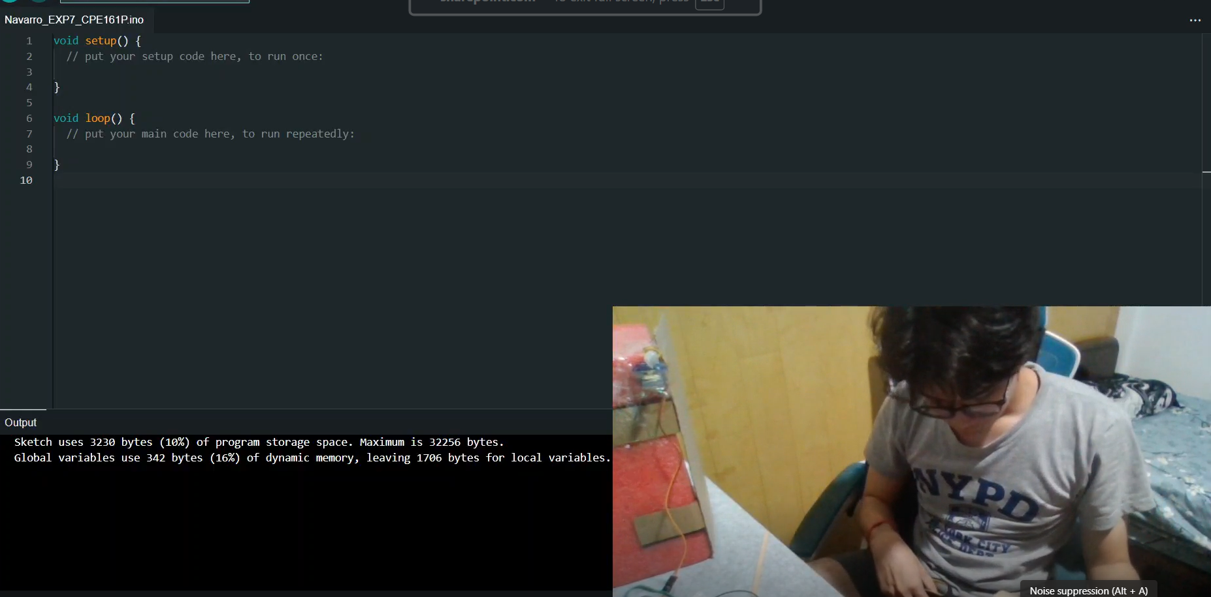
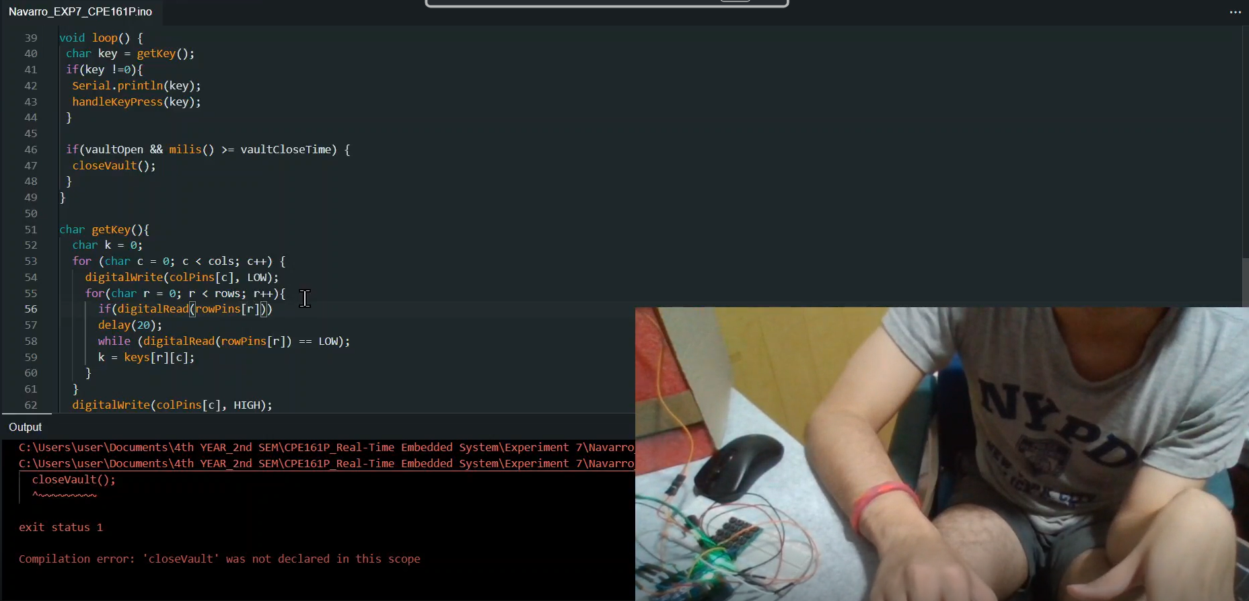
PROCEDURE

Slide 6
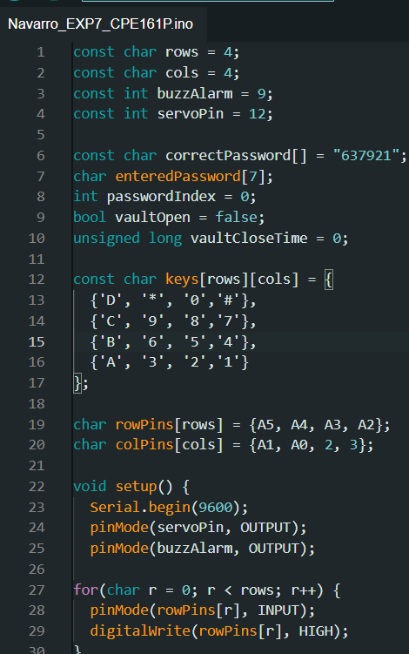
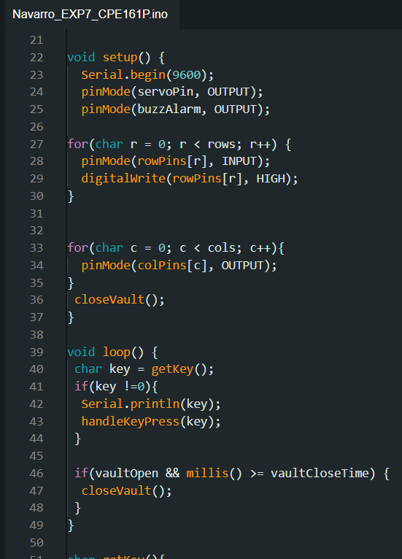
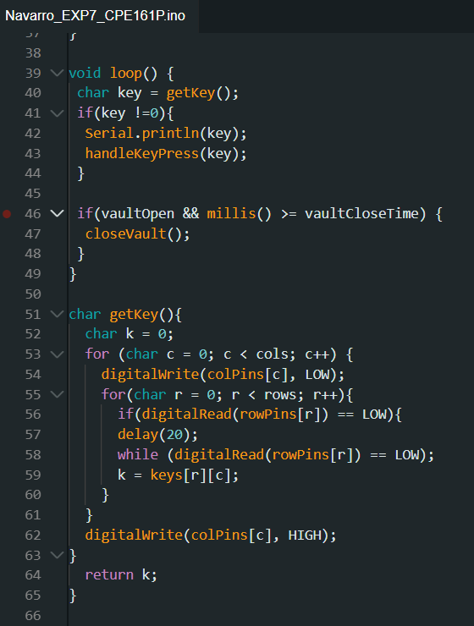
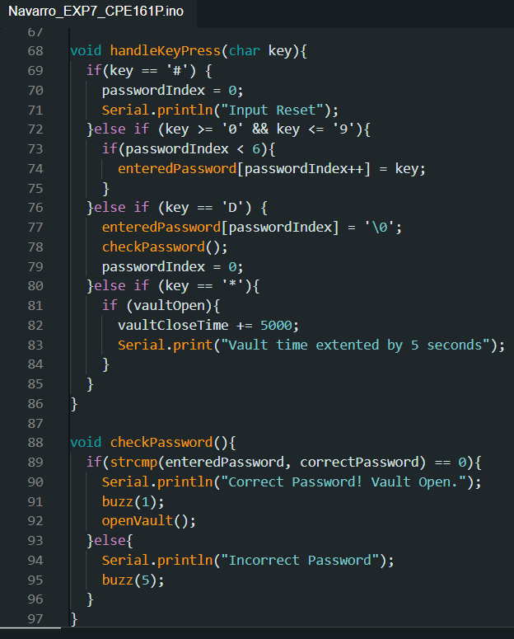
CODE

Slide 7
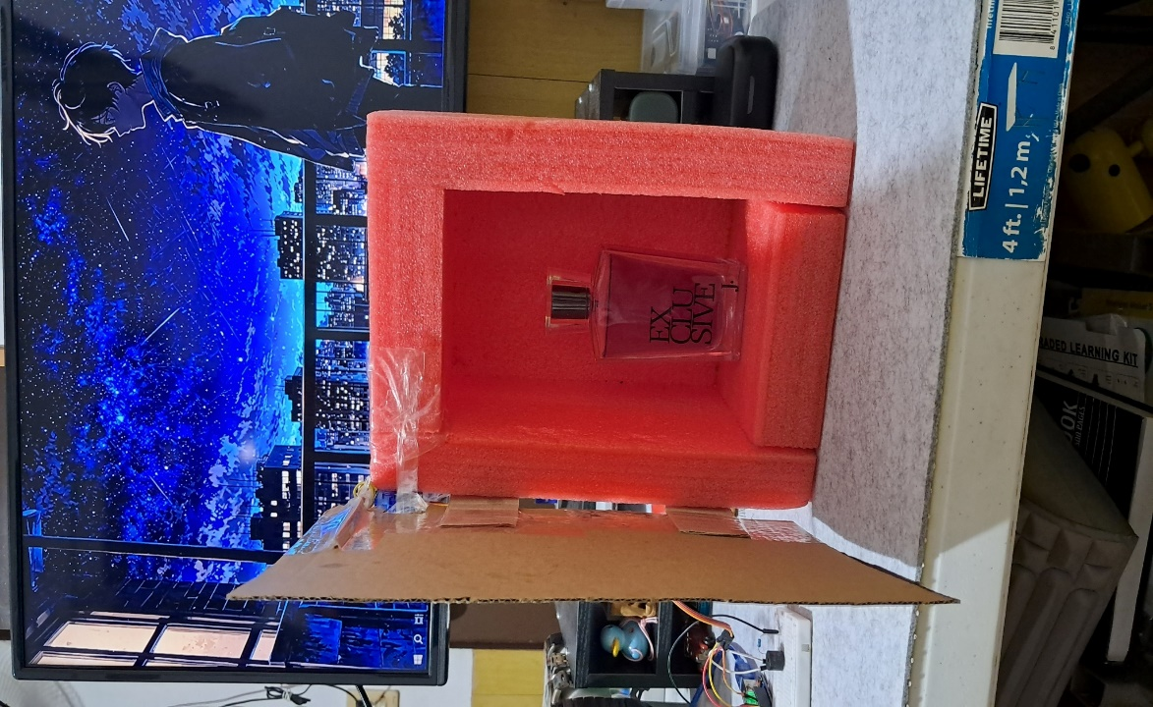
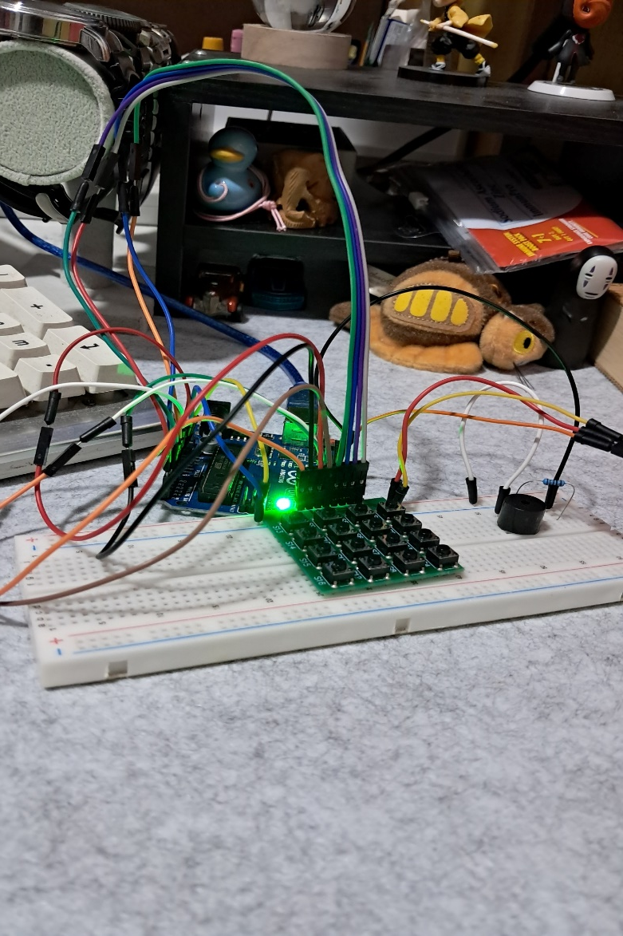
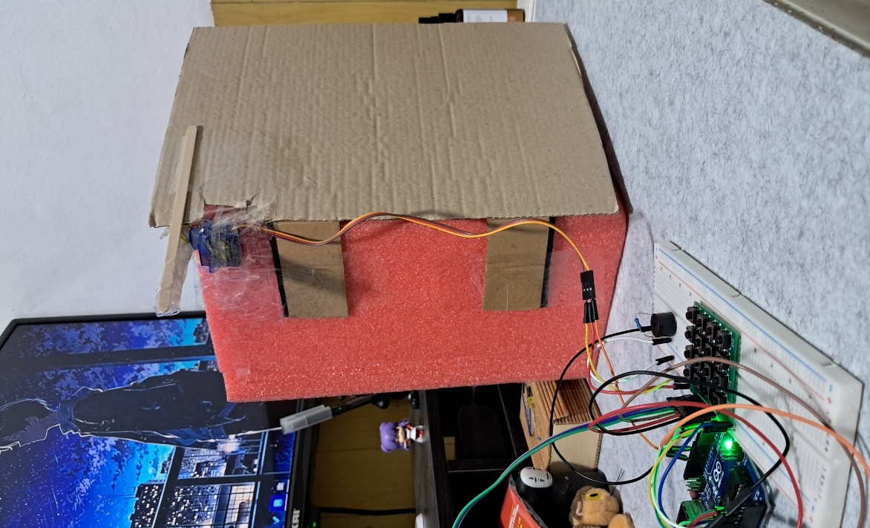
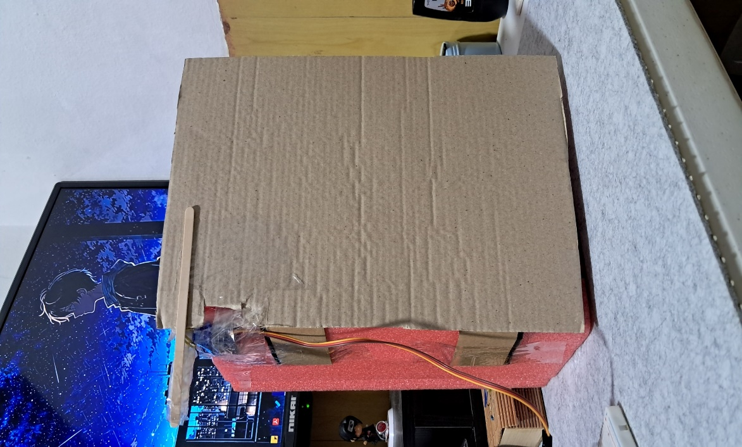
Final Output

Slide 8
THANK YOU!

